Slide 1
Fluid Universal Common Sense Syndromes from theory to Application
Learning How to Learn to SEL
Via UNESCO, Skinner, Piaget, Chomsky, Morin, Houssaye & Daesh
20th CIMQUSEF INTERNATIONAL CONFEFENCE- SOCIAL & EMOTIONAL LEARNING SEL, NOVEMBER 15-16, 2023.
© Dr. Yasmine Alnakari
yasminealnakari@gmail.com

Slide 2
What education Interest Square Unit would this image be?
https://edition.cnn.com/2023/10/23/middleeast/gaza-hospitals-doctors-disaster-intl-hnk/index.html

Slide 3
FLUID UNIVERSAL COMMON SENSE FUCC
The “Common Sense” expression is not new, and perhaps it is one of the most used in the most ambiguous and contradictory ways as long as it has been associated with controversial expressions such as:
“Holistic Natural Law”,
“ Universal Consciousness”,
“ Cosmic Memory”,
“Vitalistic Intelligence ”,
“ Common Soul”..

Slide 4
The Universal Common-Sense Fluidity (UCSF)
Common Sense is not only a physical law like the one introduced by Newton or Einstein, but it does not conflict with any objective experimental law.
Common sense is not only memories and intelligences generated and embodied exclusively by humans, but constitutes all forms of intelligences and of natural and artificial memories.

Slide 5
Two types of Fluid Universal Common Sense
First is a cosmic common sense manifested in a general Vital Logic or the Common Sense Laws
Second is crystallized in specific circumstantial forms with a variety of Vital degrees
Both can be measured by the Interest Square Unit ISU.

Slide 6
FUCS consist of the 12 Cosmic Memory Standard Matrices
5 Vital Laws VL
3 Values of Cosmic Axiomatic Trinity-
4 Interests Square Unit ISU

Slide 7
5 Formative Vital Laws of FUCS
Every being is a form, even if it appears formless
Every being is a motional, even if it seems stable
Every being is a containing, even if it appears empty
Every being is a probability, even if it seems determine
Every being is a relativity, even if it seems absolute.
Is Measured by ISU

Slide 8
5 Vital Laws
Every being is a form, even if it appears formless- the shape of the pen is a form, similar to any pen and any being as a form, but it differs from any other object and any other being because it is produced and manufactured in one formative way, destroyed in another formative way, and is similar and different in yet another distinct formative manner.
Every being is a motional, even if it seems stable- the pen is in a movement form, its material has atomic movement, its function has a movement, its validity has a beginning and an end, and its movement is similar to any kinetic form. Yet, each pen has its own physical movements and its own function.
Every being is a containing, even if it appears empty the pen is a container/containee form, its material contains/contained by atoms, electrons, protons, etc. It contains a material for writing and a value of use, and its function includes the ability to communicate and inform with multiple powers and interests similar and different from other pens based on capabilities: There is a multicolored pen, an electronic pen, etc.
Every being is a probability, even if it seems determine the pen is a probability; although it is in my hands, it remains a simple probability of existence at 100% and can become an existence at 0%. Before the fact that I buy it or receive it, the probability of having it was less than 0%, and the formulas of its appearance, manufacturing, and marketing in a certain form or another remain just possibilities in the manufacturing and marketing of pens.
Every being is a relativity, even if it seems absolute the pen is a relative form because its industrial utility value, marketing, and functionality vary for each user, each product, each market, each industry, etc.

Slide 9
3 Normative values of Cosmic Axiomatic Trinity
consist of every being (form) as instinctively attached to
1. Life, even if it seems lifeless,
2. Justice, even if it seems unjustified,
3. Freedom, even if appears incapable to be free from entropy.
Is Measured by ISU

Slide 10
4 Interest Square Units ISU matrix tool
The Formative and Normative common sense fluidity are manifested through a mathematical Interest Square Unit ISU matrices tool that consist of four units totality, partial, negativity and positivity within each the four following interests
Square One- Isolation: (Low Resonance+ Closed Circle)
Descart language (-,-)
Public langauge (weak; closed)
Square Two-Conflicting (High Resonance+ Closed Circle)
Descart language (+,-)
Public langauge (Strong; closed)
Square Three - Coe-existing (Low Resonance+ Open Circle)
Descart language (-,-)
Public langauge (weak; open)
Square Four- Unification (High Resonance+ Open Circle)
Descart language (+,+)
Public langauge (Strong; open)

Slide 11
Aristotle’s Opposite, Venn Diagram, Cartesian Square vs. Interest Square Unit ISU
Aristotle Square
Interest Square Unit ISU
Venn Diagram
Cartesian Square

Slide 12
Matrix of Education ISU
UCSF ROOTS | UCSF CRITERION
Square One - Isolation ISU Low Resonance, Closed Circulation | Double Standards – Racist, Terrosim, bullying practices. Its education interest is corrupted, exceeds an era of its time.
Square Two - Conflicting ISU High Resonance, Closed Circulation | Education based on non-scientifiic experimental hypothesis. Contradict or deny of the universal common sense’s existence VL + AT.
Square Three - Coexistence ISU Low Resonance, Open Circulation | Weak openness or non-opposition to the expression of universal common sense. (Neglect VL + AT ) Openness to critical thinking and diversity but not fully up to date in specialty.
Square Four- Unification ISU High Resonance, Open Circulation | The existence of theoretical and practical expressions affirming/confirming the reference of the fluid universal common sense (5 VL). The existence of theoretical and practical expressions consistent with the reference of the cosmic Axiomatic Trinity (3 Values).

Slide 13
How can the educational interest square be applicable to detect/inference Learning skills/activities ?
GENENERAL EDUCATION ISU | UNIFYING SQ 4 Strong Openness of Common Sense | COEXISING SQ3 Weak Openness of CS | CONFLICTING SQ2 Weak Closeness of CS | ISOLATION SQ1 Strong Closeness of CS
Practice
Theory
Oral
Text
Behavior
Image
Arts
Science

Slide 14
ISU EDUCATION COMMON SENSE DISORDER SYNDROM (Nested)
GENERAL Education ISU – Unifying/Coexistence/Conflicting/Isolation
NESTED WITHIN | UNIFICATION | COEXISTING | CONFLICTING | ISOLATION
Theory
Practice
Oral
Text
Behavior
Image
Arts
Science

Slide 15
General ISU Square #4 = Unification EDU
Skinner's Behaviorism, Edgar Morin, Noam Chomsky's Universal Grammar, Gestalt Holistic, and Jean Houssaye's Pedagogical Triangle.
The existence of theoretical and practical expressions affirming/confirming the reference of the fluid universal common sense (5 VL).
The existence of theoretical and practical expressions consistent with the reference of the cosmic Axiomatic Trinity (3 Values).

Slide 16
Edgar Morin
Edgar Morin rethinks fundamental problems that have been overlooked or neglected in education, and presents them as “Seven Complex Lessons” that should be covered in an education of the future in all societies in every culture, according to means and rules appropriate to each. With the publication of this provocative essay, UNESCO hopes to stimulate discussion on how education can and should act as a force for the future and promote a transdisciplinary perspective to meet the great challenge of durable development.
Page: 22 • Seven complex lessons in education for the future- UNESCO PUBLISHING
Edgar Morin’s General ISU
 | Unifying | Coexisting | Conflicting | Isolation

Slide 17
Edgar Morin’s ISU Nested Unifying
"By prescription and proscription the paradigm founds the axiom and expresses itself in the axiom(‘every natural phenomenon obeys determinism’, ‘every properly human phenomenon is defined by opposition to nature’, etc.)
Page: 22 • Seven complex lessons in education for the future- UNESCO PUBLISHING
The confusion results from the fact that the text contradicts to the first and fourth laws of 5 vital logic.
First : It does not mention but rather denies the existence of a formative form that combines humans and nature.
Secondly: It contradicts that the laws of scientific empiricism are in fact not deterministic, but probabilistic even if it appears deterministic.
Edgar Morin’s GENERA ISU
NESTED UNIFYING
TEXT | Conflicting | Unification
 | Isolation | Coexisting

Slide 18
Common Sense Disorder of Skinner
Skinner recognizes the capacity for learning in humans and animals,
He recognizes that common sense is not limited to humans, as it is possible to teach a mouse to salivate in its mouth even without seeing food, a response that behaviorism has not yet recognized.
With the development of AI, we have seen that it not only has the ability to learn, but it can also teach humans in return.
Skinner’s ISU GENERAL UNIFYING
NESTED UNIFYING
THEORY | Conflicting | Unification
 | Isolation | Coexisting
However, as philosophers and educators, we still fail to recognize that this phenomenon is accessible because both living and non-living entities are capable of acquiring and providing information in different forms of expression, such as computer language and satellite software, for example, also fall into the category of vital behavioral language (VBL). Coexistence

Slide 19
Common Sense Disorder of Noam Chomsky
Noam Chomsky’s GENERAL ISU
NESTED UNIFYING
TEXT & THEORY | Conflicting | Unification
 | Isolation | Coexisting
We can appreciate the positivity of Noam Chomsky's recognition of the existence of the innate expression of a "grammar", which he calls Universal Grammar, general to all human beings, as he does not connect it to incentives of the human external learning environment languages.
Thus, Chomsky is still unable to accept the existence of laws of cosmic memory, experienced through VBL from the behavior of man to the behavior of dust. As it he may still not recognize that behavioral languages, for example, are not limited to a mouse's reaction of creating its own saliva just at the thought of food.
To say that there is universal intelligence in common sense communication does not mean that the interests of communication are the same. Claude Elwood Shannon scientifically proves that every being, expression, silence and all other forms of communication express information measured in units of bits, whether it is understandable, intentional, or whether it is a message, a messenger or a receiver.

Slide 20
Gestalt’s Holistic Approach
Although Gestalt made a valuable contribution in focusing on language learning through the overall context of linguistic change, but the problem remains due to the disturbance of the concept of Holistic itself, which is well-known for its shortcomings throughout history.
As the vital logic depends on the concept of the 'whole' for learning in general or in language learning implicitly through the ISU, the 'total unit' of the Interest Square Unit (ISU) includes not only the whole but also two interconnected faculties, from negative to positive, and with their paradoxical particles. The 'whole' of any word consists of a waterfall of paradoxes, and this is what has outlived the language memory of any vital behavioral linguistic learning.
Gestalt's GENERAL ISU
NESTED UNIFYING
TEXT & THEORY | Conflicting | Unification
 | Isolation | Coexisting

Slide 21
Jean Houssaye’s Educational ISU Unifying
He wrote : «DESCARTES can thus be considered as the reference point for the "teaching" process because, if "Good sense is the best-distributed thing in the world" (1637-1965, p. 25), clear and distinct ideas are universal and impose themselves in a way, so all that's needed is to transmit them.)
Jean Houssay. Page 159-163. Théorie et pratiques de l'éducation scolaire (I) Le triangle pédagogique.
Jean Houssaye’s GENERAL ISU
TEXT & THEORY | Unification | Coexist | Conflict | Isolation

Slide 22
Is Jean Houssaye’s Educational Trianlge truly an ISU Unifying ?
Despite his knowledge of and admiration for the universality of common sense in Descartes, ـJ. Houssaye in his curriculum for teaching philosophy in the French baccalaureate, he contentedly recommends teaching knowledge according to Western philosophy instead of embracing the diversity of world cultures as equals in sharing the logic of common sense. This results in the exclusive teaching of the history of Western philosophy for the BAC.
See Jean Houssay. The Pedagogical Triangle. Page 160 EXAMPLE PHIL0 - KNOWLEDGE/GENERAL OBJECTIVE,
Jean Houssaye’s GENERAL ISU
NESTED UNIFYING
THEORY | Conflicting | Unification
 | Isolation | Coexisting

Slide 23
General ISU Square #3 = Coexistence ex. UNESCO Towards a common-sense law for the future of education
Although UNESCO is a well-known international organization that has allocated budgets among the highest levels of education globally, but that has also had political and administrative conflicts, causing powerful countries like the United States of America to withdraw from the organization and cease their contributions. It is important to recognize UNESCO's achievements, including preserving world heritage sites and implementing programs such as the global citizenship program10 to assist poor countries in developing their educational programs.
However, despite holding hundreds and thousands of seminars and publishing dozens if not hundreds of educational research articles since its founding in 1946, we found a lack as an exact term of ‘common-sense’ or of a conceptacle reference to the universal common-sense laws. As well as, a clear absence in presenting any concrete plans toward any academic research to discover the roots of the educational laws from a formative and normative educational background, meanwhile it does not negate their openness to it.
Weak openness or non-opposition to the expression of universal common sense.
Openness to critical thinking and diversity but not fully up to date in specialty .
UNESCO’s GENERAL ISU
PRACTICE & ORGANIZATION | Unifying | Coexisting | Conflicting | Isolation

Slide 24
UNESCO Nested ISU Coexisting
It is evident to everyone who has reviewed this presentation and followed UNESCO's activities that UNESCO is lagging behind at least half a century in the cognitive of the Hayawic Vital Theory and in the Vital Hayawic Education application. This can be justified as UNESCO is an organization of states and governments therefore, it does not welcome opposing thinkers to their governmental members of UNESCO, unless they are supported by other influential countries within UNESCO.
Hence, the absence of any impact for example of the name of such Raiek Alnakari or the other researchers of the Damascus School, over more than 60 years since the appearance of their work, have not had any recognition, is not surprising but rather an indicator that the UNESCO’s is not a unifying organization for the least nor an up to the state of the art as it may have been known for.
UNESCO’s GENERAL ISU
NESTED COEXSTING
Practice & Organization | Conflicting | Unification
 | Isolation | Coexistence

Slide 25
General ISU Square #2 = Conflicting ex. Jean Piaget
a- Education based on non-scientifiic experimental hypothesis
b- Denial or neglect of the universal common sense’s existence
His research, which primarily focused on the cognitive development of children, has faced criticism due to its limitations. Piaget's initial observations were predominantly conducted on his own three children and nephew, making it difficult to generalize his findings as valid with time to the experts of the field, as well as, his neglect to his selection of study, not considering the different age-groups, mental disabilities, ethnicity, social status, and economic backgrounds. Moreover, his research emphasis on cognitive development stages and biological maturity lacked clarity within his definitions of theory, hence a lack in providing efficient scientific definitions to his work, hindering replication when needed.
Jean Piaget’s GENERAL ISU
THEORY | Unification | Coexisting | Conflicting | Isolation

Slide 26
Jean Piaget: Common Sense Disorder
Justification
Unfortunately, a large portion of American and European educators have relied heavily on the data promoted by Jean Piaget's studies as biological facts implemented in the education system. Since everything can be improved, Jean Piaget's biological studies were proven wrong, including his recommendation not to teach logical and ethical topics to children under the age of seven due to the inability of brain maturation children to understand abstraction. until the age of 11. This idea is not only false but also disastrous. This is where we can introduce the significance of Matthew Lippman and others, who showed not only the absence of common sense through the studies of Jean Piaget, but also the error of common sense.

Slide 27
General ISU Square #1= Isolation ex. Daesh ISIS
a: Terrorisme practice
b. Its education interest is corrupted, exceeds an era of its time.
Justification: this research will not provide more about the example of ISIS because the example its self has become well known, documented, and globally condemned as it appeared what results it has done triggering civil wars in Syria, Iraq, Afghanistan, and many African countries, and many terrorist movements that spread to Europe and the United States. America
Daesh ISIS’s GENERAL ISU
PRACTICE & THEORY | Unifying | Coexisting | Conflicting | Isolation

Slide 28
Background History Damascus School Hawayic Logic
Raiek Alnakari, my father, is firstly a modern artist, novelist, and most importantly, the founder of the Hayawic / Vital Logic with the Hayawic group researchers Gilles Deleuze, François Châtelet and René Schérer by the name “Damascus School”.
The (DSHL) founded by my father was after the 1967's war, in which was applied as an interdisciplinary cognitive engineering. He taught its principles at several universities of different countries in France, Algeria and Cairo.
He has written over forty books, most of which were banned from publication, to the latest being the encyclopedia "Quran al-Quran, Bible of the Bible, Torah al-Torah." 16 volumes, the first and 11th volumes were published In 2018 and 2019.
References
Alnakari, R. (1970). L’Idéologie Hayawic (Vitale). Damas, Syrie: Dar Althabat.
Alnakari, R. (1971). L’Identité Nationalité Arabe. Damas, Syrie: Dar Al-Alm.
Alnakari, R. (1972). L’Identité de Nationalité Zionist. Damas, Syrie: Dar Al-Alm.
Alnakari, R. (1974). L’Homme est Forme. Damas, Syrie: Dar Al-Alm.
Alnakari, R. (1975). La loi Hayawic (Vitale) de l’univers. Damas, Syrie: Dar Al-Alm.
Alnakari, R. (1976). La Théorie Hayawic (Vitale) de la connaissance. Damas, Dar Al-Anwar.
Alnakari, R. (1978). Le programme politique Hayawic (Vitale). Baghdad, Irak : Alnakari.
Alnakari, R. (1984). Le principe Hayawic dans la pensée philosophique et politique arabe contemporaine d'après le modéle syrien : application de la loi Hayawic à l'étude sociale. Non publié (thèse de doctorat) Vincennes-Saint Denis Univeristé Paris 8, Paris, France.
Alnakari, R. (1987). La logique Hayawic, la Raison de la Raison- La science de la pensée et de la politique". (Tomes 1-4). Paris, France: International Edition Paris.
I. La Loi et la Raison
II. La Raison de la Loi
III. La Loi et la Raison Individuellement Psychologiquement.
IV. Le Non-Loi et le Non-Raison.

Slide 29
The Vital ISU Measurement
This vital measure of intelligence does not measure knowledge of information or memory, but it measures the intelligence of Common sense in practicing and applying information according to the technique of the Interest Square by diagnosing each of
1. Identity -Isolation Interest square
2. Priority- Conflicting Interest square
3. Memory- Coe-existing Interest square
4. standardization - Unification Interest Square
It is a measure that requires no prior explanation to assess the criteria of disturbance in learning, knowledge of knowledge, or measurement of sensory, psychological, cognitive, educational, and linguistic measurements.

Slide 30
Interest Square Units
CONFLICTING | UNIFICATION
ISOLATION | COEXSITING

Slide 31
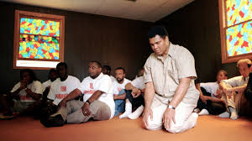
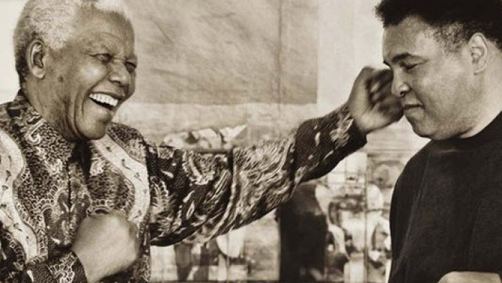
Identity -Isolation Interest Square Muhammed Ali Clay
Where would you place each image, and why?

Slide 32
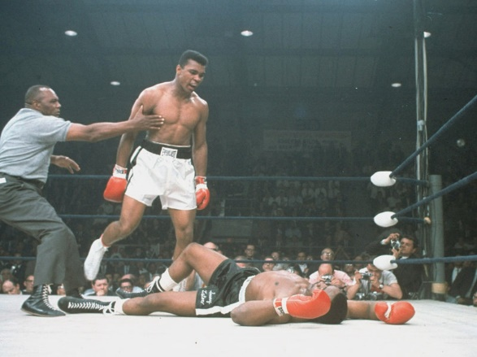
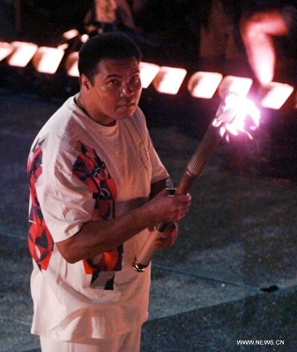
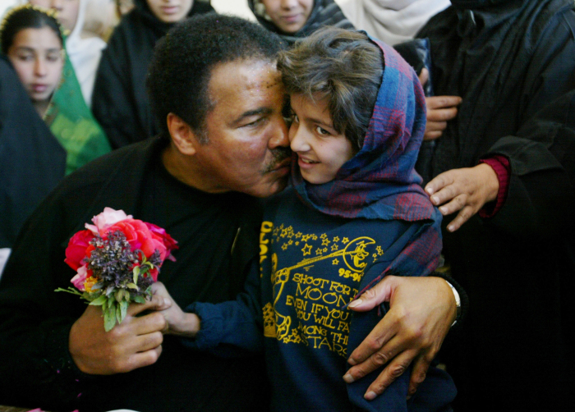
Priority- Conflicting Interest Square Muhammed Ali Clay
Where would you place each image, and why?

Slide 33
Inspired Motives of this research
It all started from the Syrian war, not knowing that I was directly leading to my father’s path.
As an educator, I believed that if there was any change to occur, we had to start integrating learning-teaching methods, with short and intermittent doses of mental storm to activate the students’ common sense, preferably linked to the official educational systems by integrating it through an extracurricular, that would not require our memories but rather our common sense.
As I started my research in applying the curriculum to students from primary and on to middle school classes in Damascus- spring of 2014 and 2015 under the missile attacks, leading it to my thesis 2019.
continued the research on to public schools of Paris, leading me to the fieldwork of the Professional (vocational) School in the suburbs of Paris from 2021 to 2022.
Discovering from the first minutes, that these particular students were victims of very poor educational management on to suffering from deprived curricula based on the universal common Sense; when the students’ future and success were classified based on the measurement of parrot-like memory retaining information rather than retaining information from the fluid common sense memory.
Leading me to prioritize first in detecting the Common-sense disorder syndrome CSDS provided by the references of the educational theorists, institutions & organizations. As a result, I had to document a brief history of the founder of the Universal Common-sense research stages & developments and the impact of its absence on the intellectual references of the political agendas.

Slide 34
Reference
Alnakari Yasmine, "LES INTÉRETS ÉDUCATIFS DE LA PÉDAGOGIE INSPIRÉE DU CARRÉ LOGIQUE.” Volume1: 400 pages + Volume 2: ANNEX ~500 pages. 2019

